Slide 1

Chapter
9
Achieving Operational Excellence and Customer Intimacy: Enterprise Applications

Slide 2
Management Information Systems
Chapter 9 Achieving Operational Excellence and Customer Intimacy: Enterprise Applications
LEARNING OBJECTIVES
Demonstrate how enterprise systems achieve operational excellence by integrating and coordinating diverse functions and business processes in the firm.
Demonstrate how supply chain management systems coordinate planning, production, and logistics with suppliers.
Demonstrate how customer relationship management systems achieve customer intimacy by integrating all customer information and making it available throughout the firm.

Slide 3
Management Information Systems
Chapter 9 Achieving Operational Excellence and Customer Intimacy: Enterprise Applications
LEARNING OBJECTIVES (cont’d)
Assess the challenges posed by enterprise applications.
Describe how enterprise applications can be used in platforms for new cross-functional services.

Slide 4
Management Information Systems
Chapter 9 Achieving Operational Excellence and Customer Intimacy: Enterprise Applications
Whirlpool Fixes Its Supply Chain
Problem: Uncontrollable supply chain, outdated systems.
Solutions: Eliminate manual procedures and implement supply chain software suite to allocate inventory more accurately and forecast demand.
i2 Technologies forecasting software and SAP ERP software reduce inventory and increase sales.
Demonstrates IT’s role in coordinating supply chains.
Illustrates digital technology as part of a solution that can benefit both a firm and its customers.

Slide 5
Management Information Systems
Chapter 9 Achieving Operational Excellence and Customer Intimacy: Enterprise Applications
Enterprise Systems
What are enterprise systems?
Enterprise software
  Best practices
Business value of enterprise systems

Slide 6
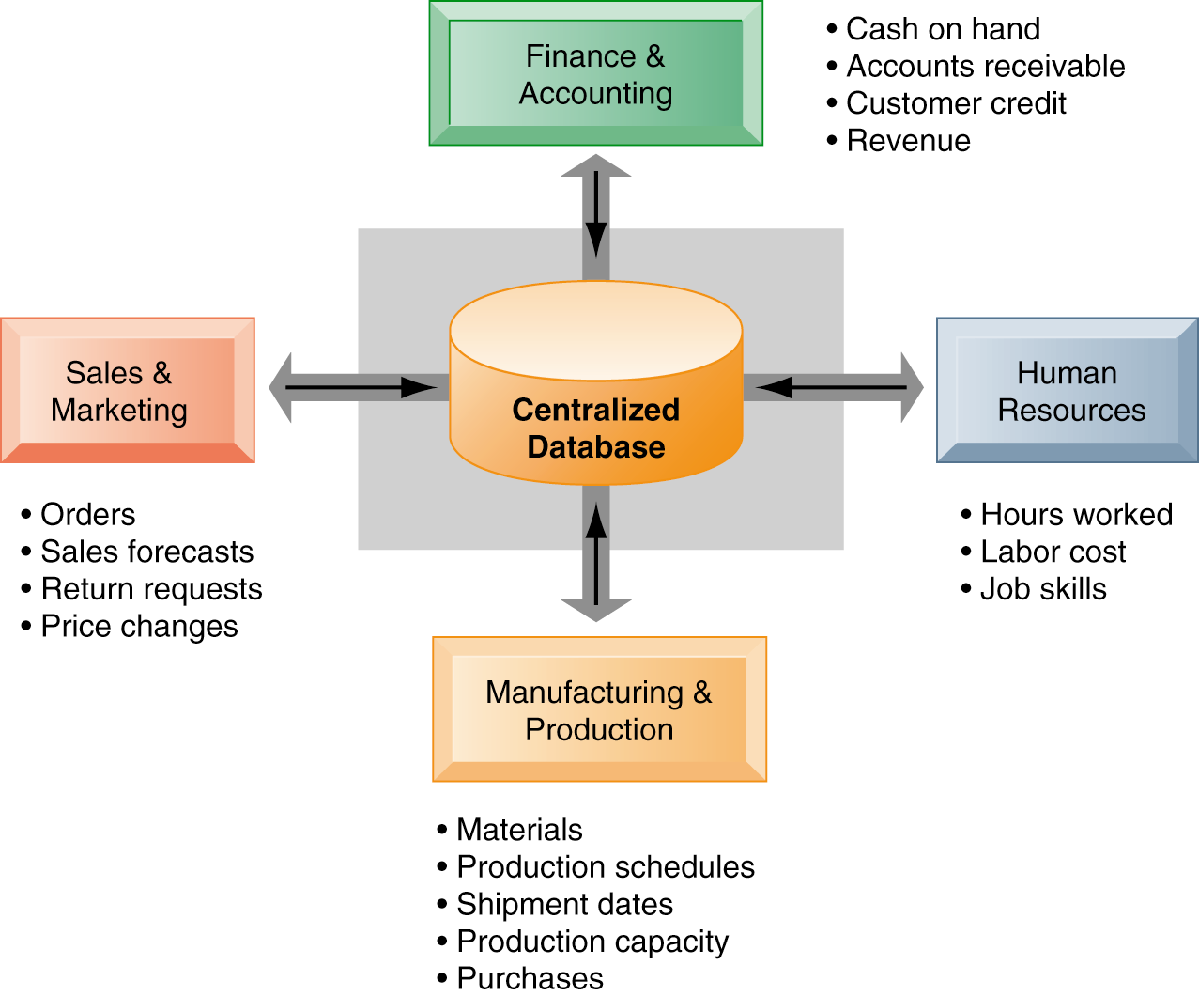
Management Information Systems
Chapter 9 Achieving Operational Excellence and Customer Intimacy: Enterprise Applications
Enterprise Systems
How Enterprise Systems Work
Enterprise systems feature a set of integrated software modules and a central database that enables data to be shared by many different business processes and functional areas throughout the enterprise.
Figure 9-1

Slide 7
Management Information Systems
Chapter 9 Achieving Operational Excellence and Customer Intimacy: Enterprise Applications
Supply Chain Management Systems
The supply chain
Information and supply chain management
Supply chain management applications
Supply chain management and the Internet
  Demand-driven supply chains: From push to pull manufacturing and efficient customer response
Business value of supply chain management systems

Slide 8
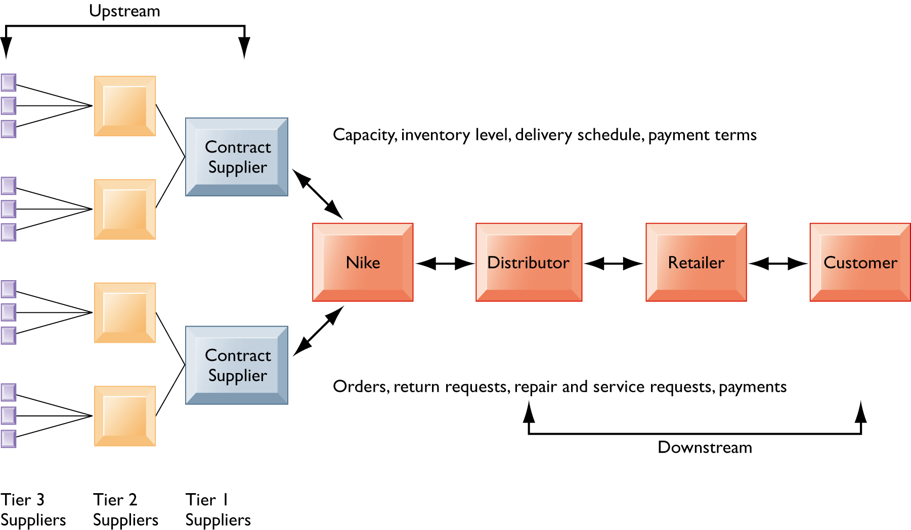
Management Information Systems
Chapter 9 Achieving Operational Excellence and Customer Intimacy: Enterprise Applications
Supply Chain Management Systems
Nike’s Supply Chain
This figure illustrates the major entities in Nike’s supply chain and the flow of information upstream and downstream to coordinate the activities involved in buying, making, and moving a product. Shown here is a simplified supply chain, with the upstream portion focusing only on the suppliers for sneakers and sneaker soles.
Figure 9-2

Slide 9
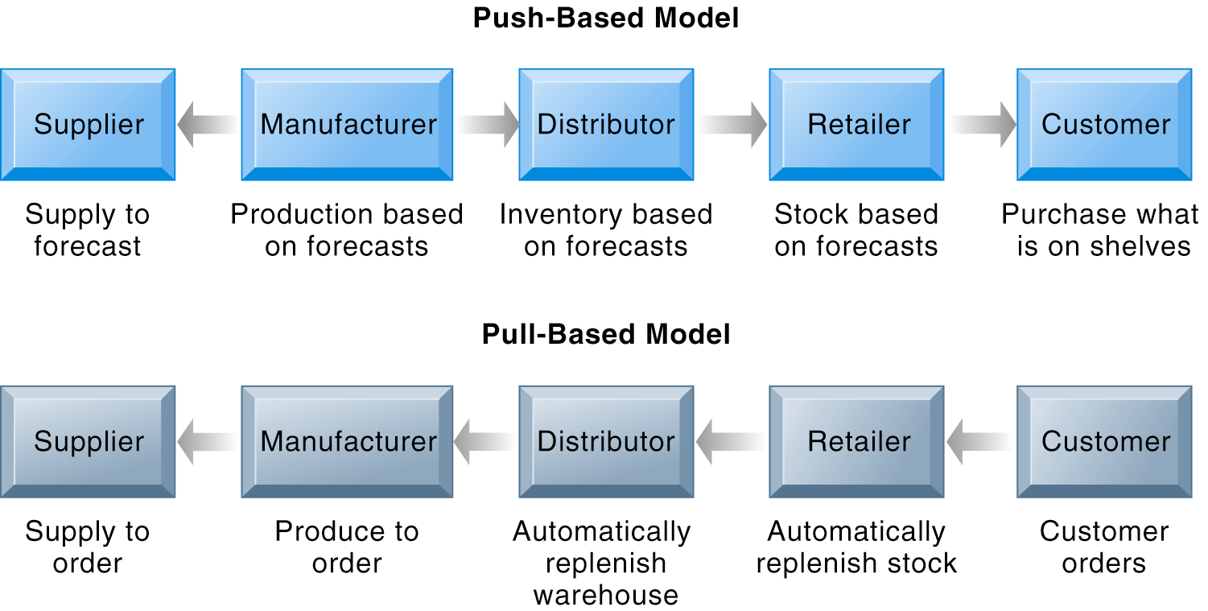
Management Information Systems
Chapter 9 Achieving Operational Excellence and Customer Intimacy: Enterprise Applications
Supply Chain Management Systems
Push- Versus Pull-Based Supply Chain Models
The difference between push- and pull-based models is summarized by the slogan “Make what we sell, not sell what we make.”
Figure 9-5

Slide 10
Management Information Systems
Chapter 9 Achieving Operational Excellence and Customer Intimacy: Enterprise Applications
Customer Relationship Management Systems
What is customer relationship management
Customer relationship management software
  Sales force automation (SFA)
  Customer service
  Marketing
Operational and analytical CRM
Business value of customer relationship management sytems

Slide 11
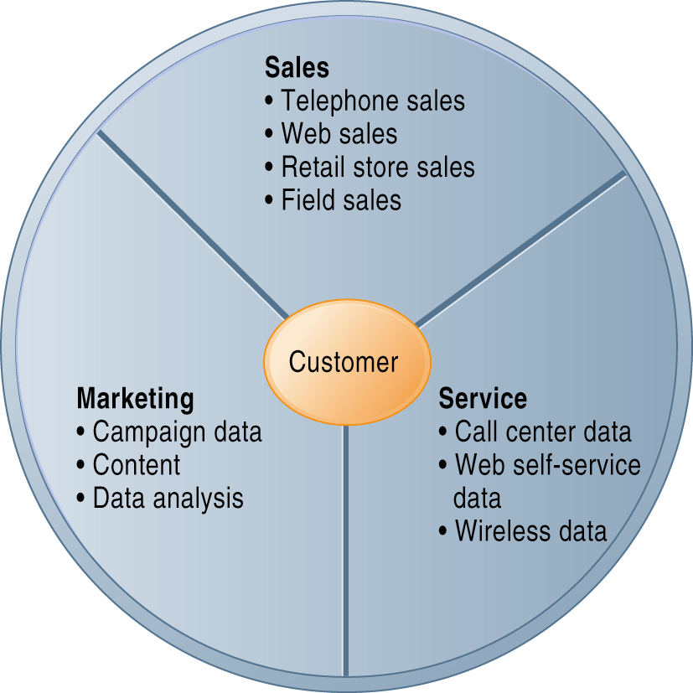
Management Information Systems
Chapter 9 Achieving Operational Excellence and Customer Intimacy: Enterprise Applications
Customer Relationship Management (CRM)
CRM systems examine customers from a multifaceted perspective. These systems use a set of integrated applications to address all aspects of the customer relationship, including customer service, sales, and marketing.
Figure 9-7

Slide 12
Management Information Systems
Chapter 9 Achieving Operational Excellence and Customer Intimacy: Enterprise Applications
Customer Relationship Management Systems
IHOP Cooks Customer Data to Order
Read the Interactive Session: Technology, and then discuss the following questions:
  How does knowledge of customers impact IHOP’s business performance?
  Why did IHOP have trouble getting to know its customers?
  How has the company chosen to improve its knowledge of customers? Analyze the management, organization, and technology dimensions of the solution.
  Did IHOP choose the best solution? Explain your answer.

Slide 13
Management Information Systems
Chapter 9 Achieving Operational Excellence and Customer Intimacy: Enterprise Applications
Enterprise Applications: New Opportunities and Challenges
Enterprise application challenges
Extending enterprise software
  Service platforms
  Security outsourcing

Slide 14
Management Information Systems
Chapter 9 Achieving Operational Excellence and Customer Intimacy: Enterprise Applications
Enterprise Applications: New Opportunities and Challenges
Invacare Struggles with Its Enterprise System Implementation
Read the Interactive Session: Organizations, and then discuss the following questions:
  How did problems implementing the Oracle enterprise software affect Invacare’s business performance?
  What management, organization, and technology factors affected Invacare’s ERP implementation?
  If you were Invacare’s management, what steps would you have taken to prevent these problems?

